Slide 1
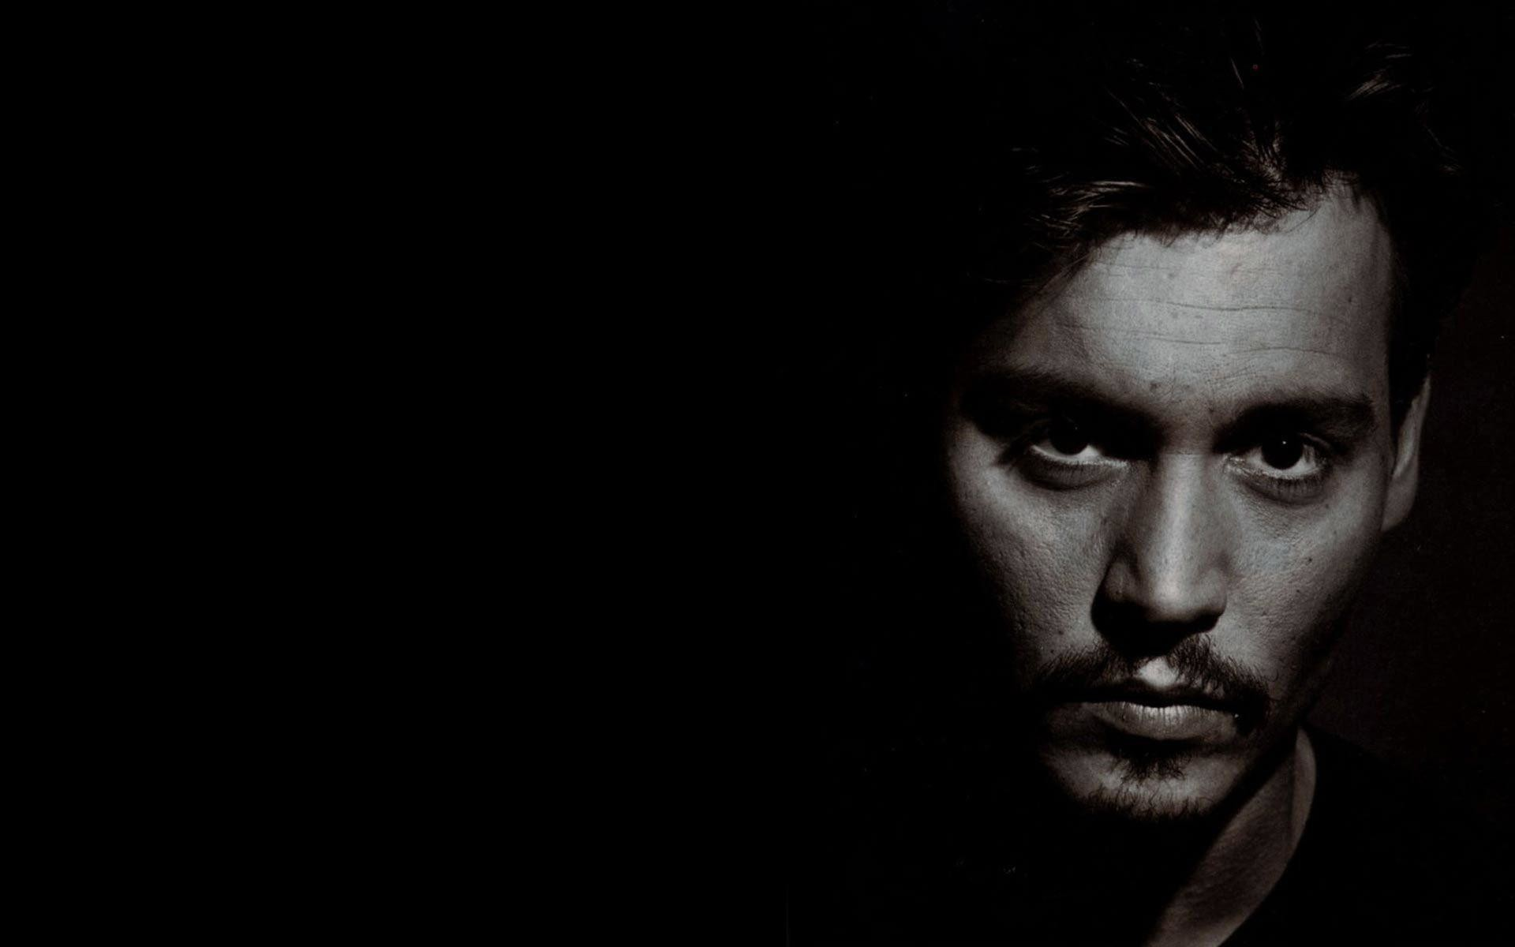
JOHNNY DEPP

Slide 2
Picture a pirate

Slide 3
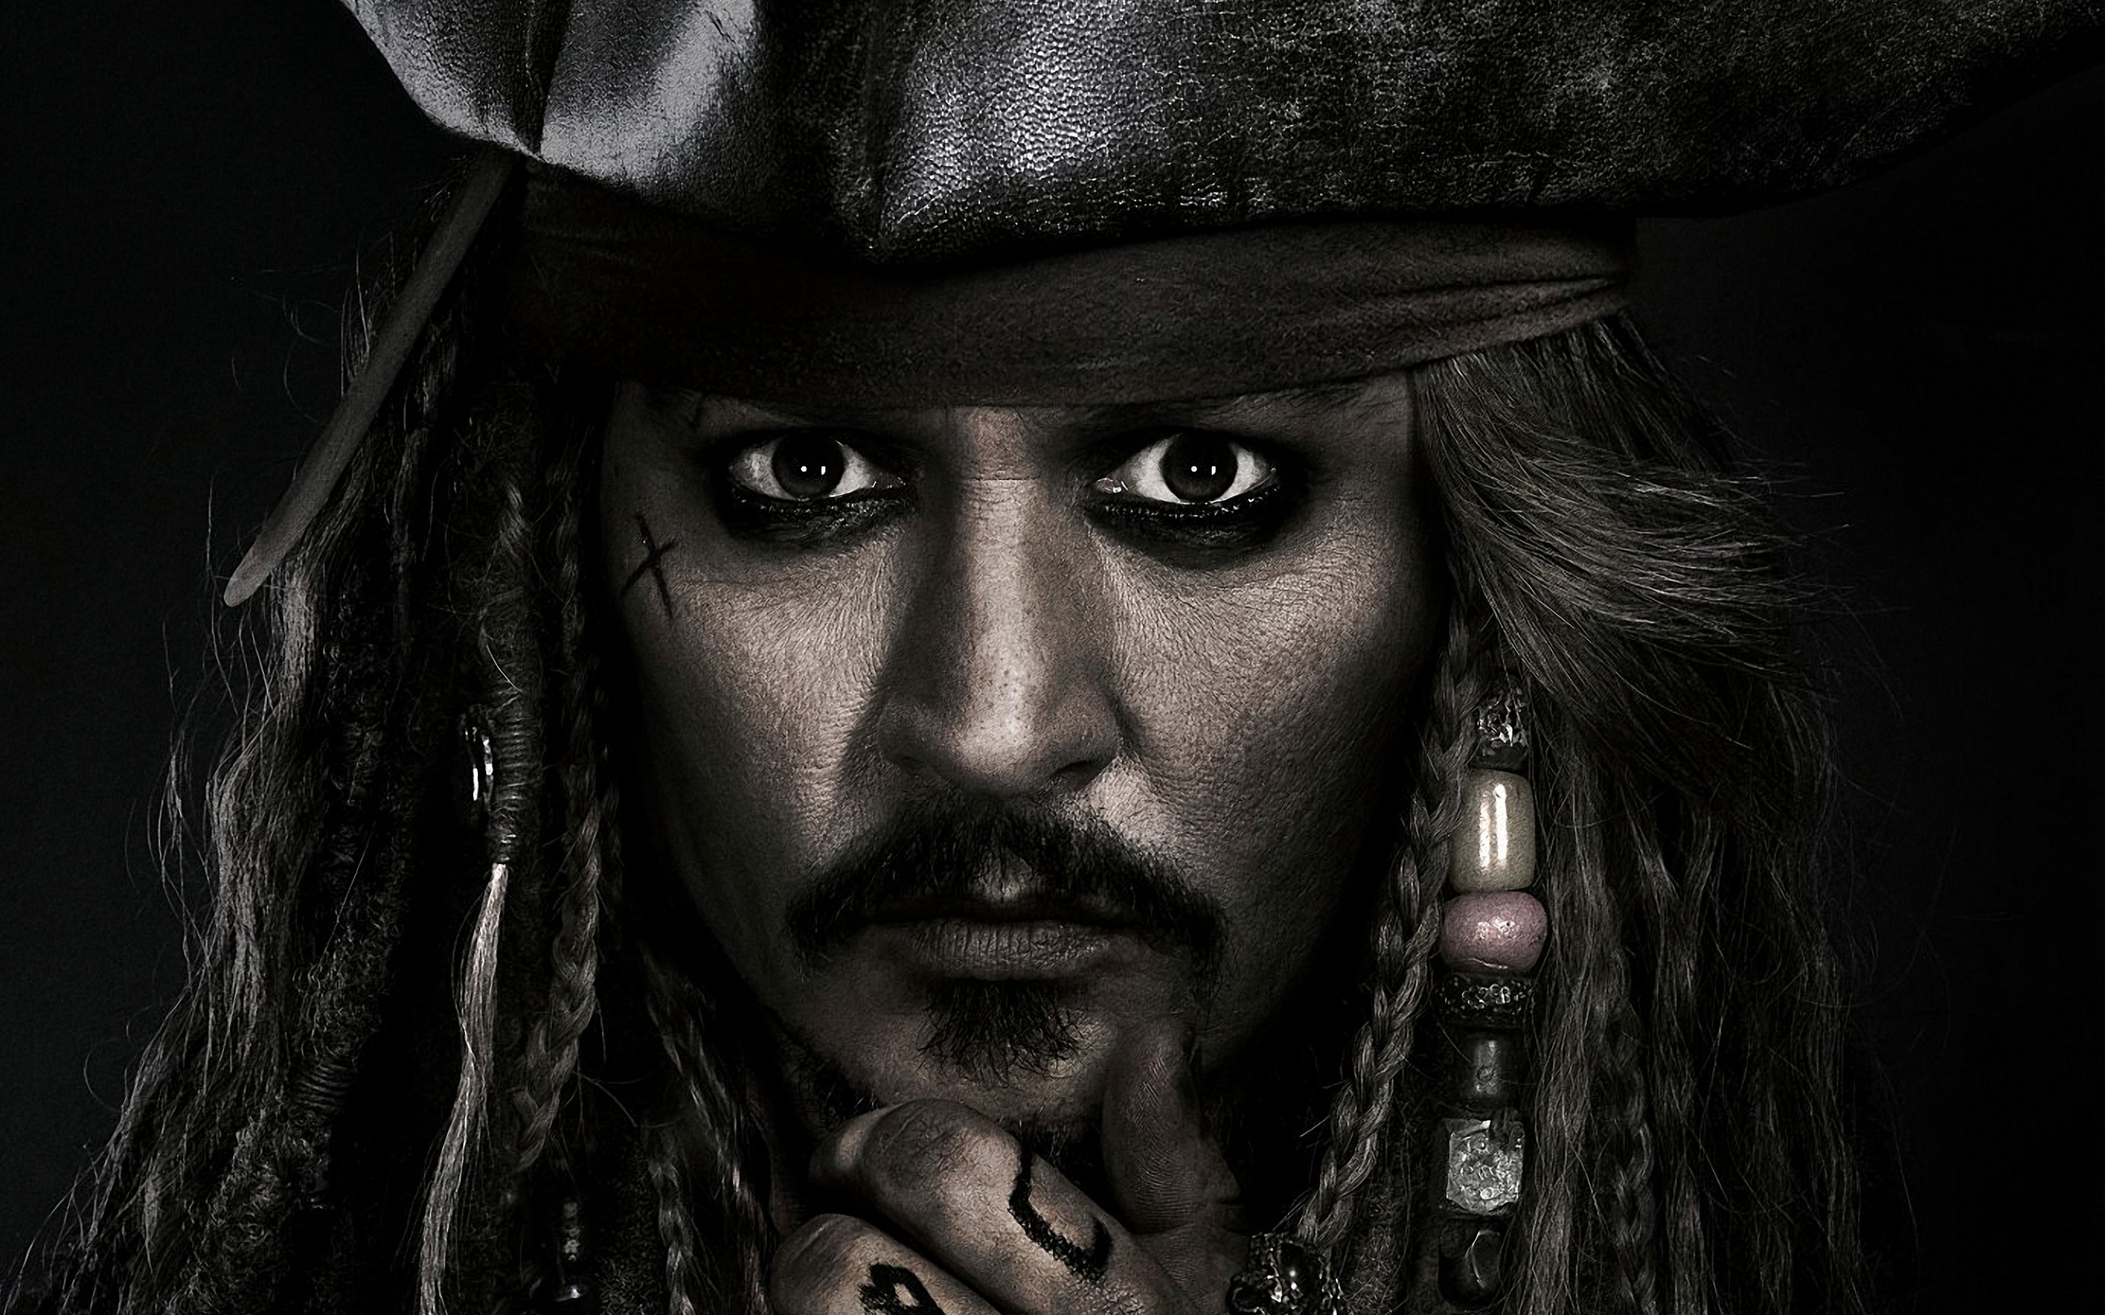

Slide 4
a drug addict teen
failures
was considered useless by own family
longed for true love
a teen who failed his life

Slide 5
highest paid actors – now
10 golden globe award nominations
but his journey to it was not easy
moral
motivation

Slide 6
FAMILY
Father – engineer
Mother – waitress at a motel
4th child
Grew up seeing his father abuse his mother
Moved over 20 cities.
so no proper friends / love
Depression – smoking,drinking ,drugs and music
Expelled from school
Parents finally divorced

Slide 7
NEW BEGINNINGS
On his own
Guitarist - joins a band “kits”
Falls in love
Marriage at 20
Financially broke.
Wife’s ex-boyfriend - Nicolas cage
Cage advised him to pursue acting due to his weird body language and attitude.

Slide 8
ACTOR
Attended auditions
Got a opportunity in a tv series -“21 jump street”
American girls were magnetized by his attitude
Got voted as teenage icon by American youngsters

Slide 9
DOWNHILL
Got quite famous and rich
Had several relationships
2 daughters
Life was turning worse
No block busters
No appreciable achievements
Wanted to break his image of being a wrong inspiration for youngsters
He tattoos every time he has a relationship, at the end he is only left with the scar

Slide 10
LONGING
He was waiting for a iconic role
He longed that none of his films could be shown to his daughters

Slide 11
GOOD NEWS
from 1999 Disney productions were in a effort of producing a movie-”Pirates of the Caribbean”
They couldn’t find an actor to play a character called “Jack Sparrow” ,a drunkard pirate
It was just a side role,not much of importance
They thought of casting Hugh Jackman . One of the reasons why the character is named Jack.
But he was unable to do it
Johnny was roped in

Slide 12
JACK SPARROW
He reads the script .
This was the kind of character he longed for.
Studies his character and he performs in front of the crew.
criticized by producers for playing it like a gay
He is about to be dropped from the film.
Gets convinced by one of the producers
The movie hits the screens.

Slide 13
WORLD WIDE RECOGNITION
A massive hit. gets recognition as the best actor.
Inner satisfaction –an achievementt.
All the sequels of Pirates of the Caribbean turns to be a massive box office hit for the sole reason of the character Jacksparrow.

Slide 14
QUOTES

Slide 15
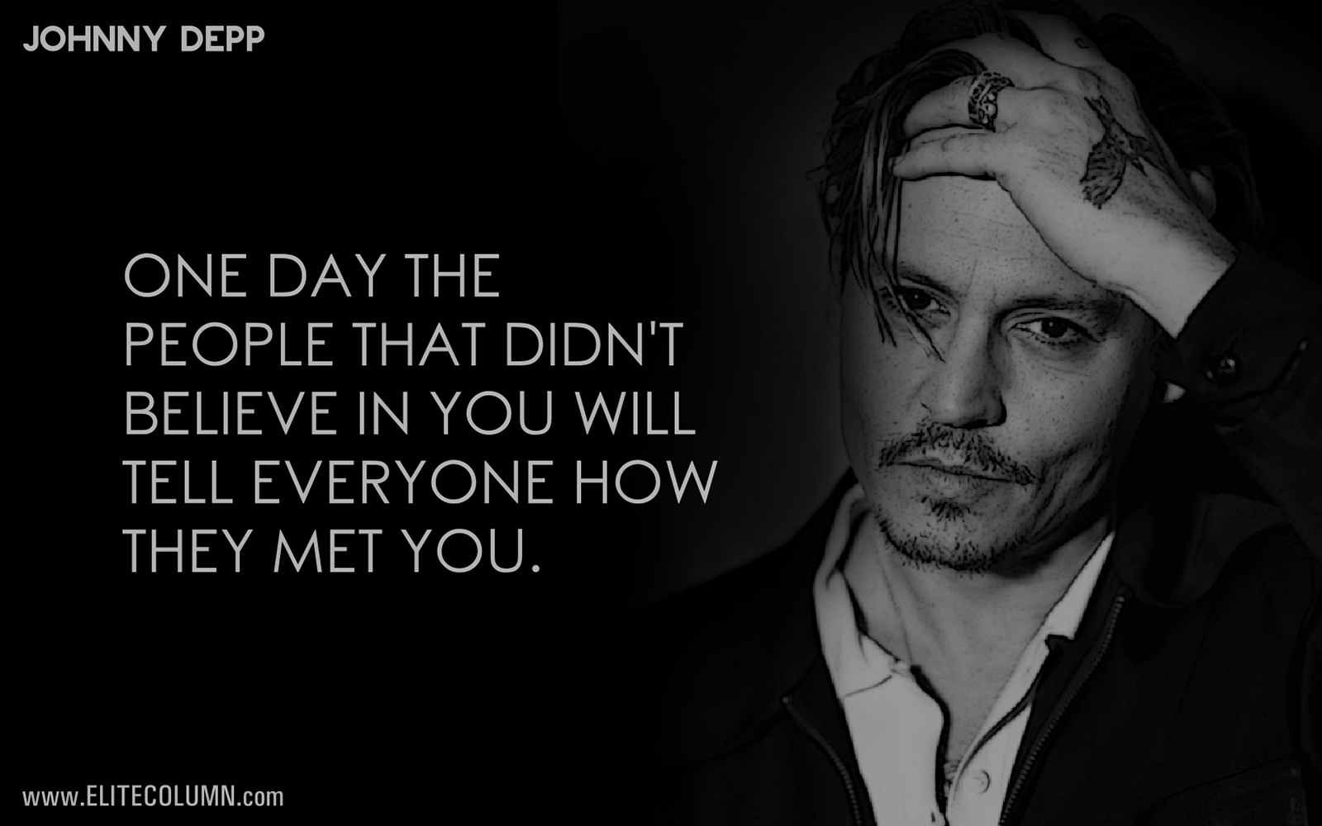

Slide 16
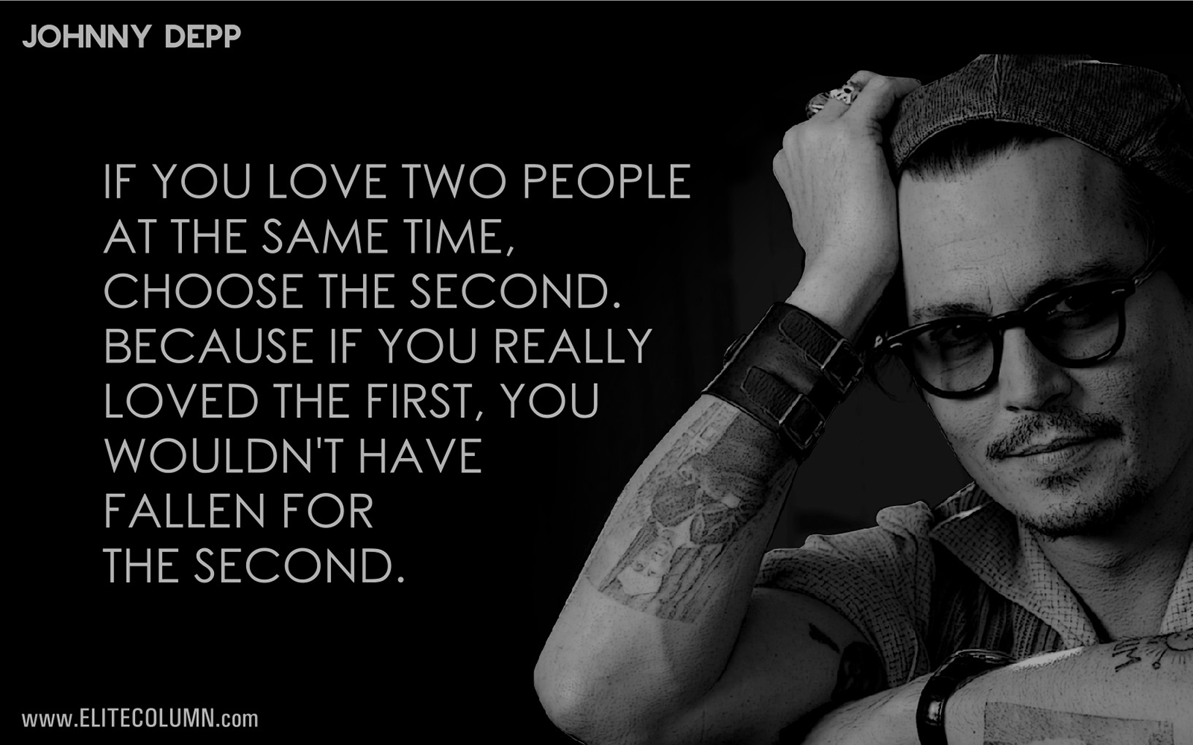

Slide 17
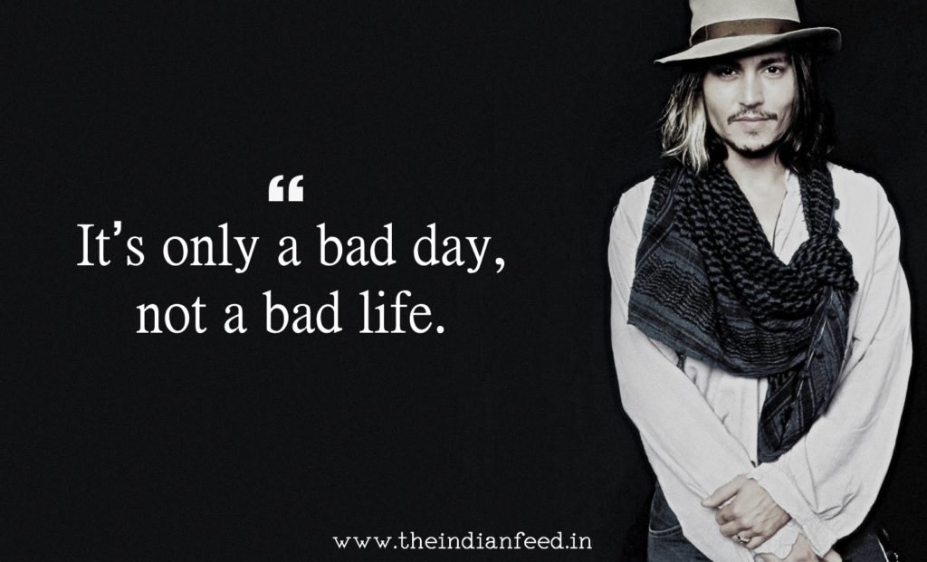

Slide 18
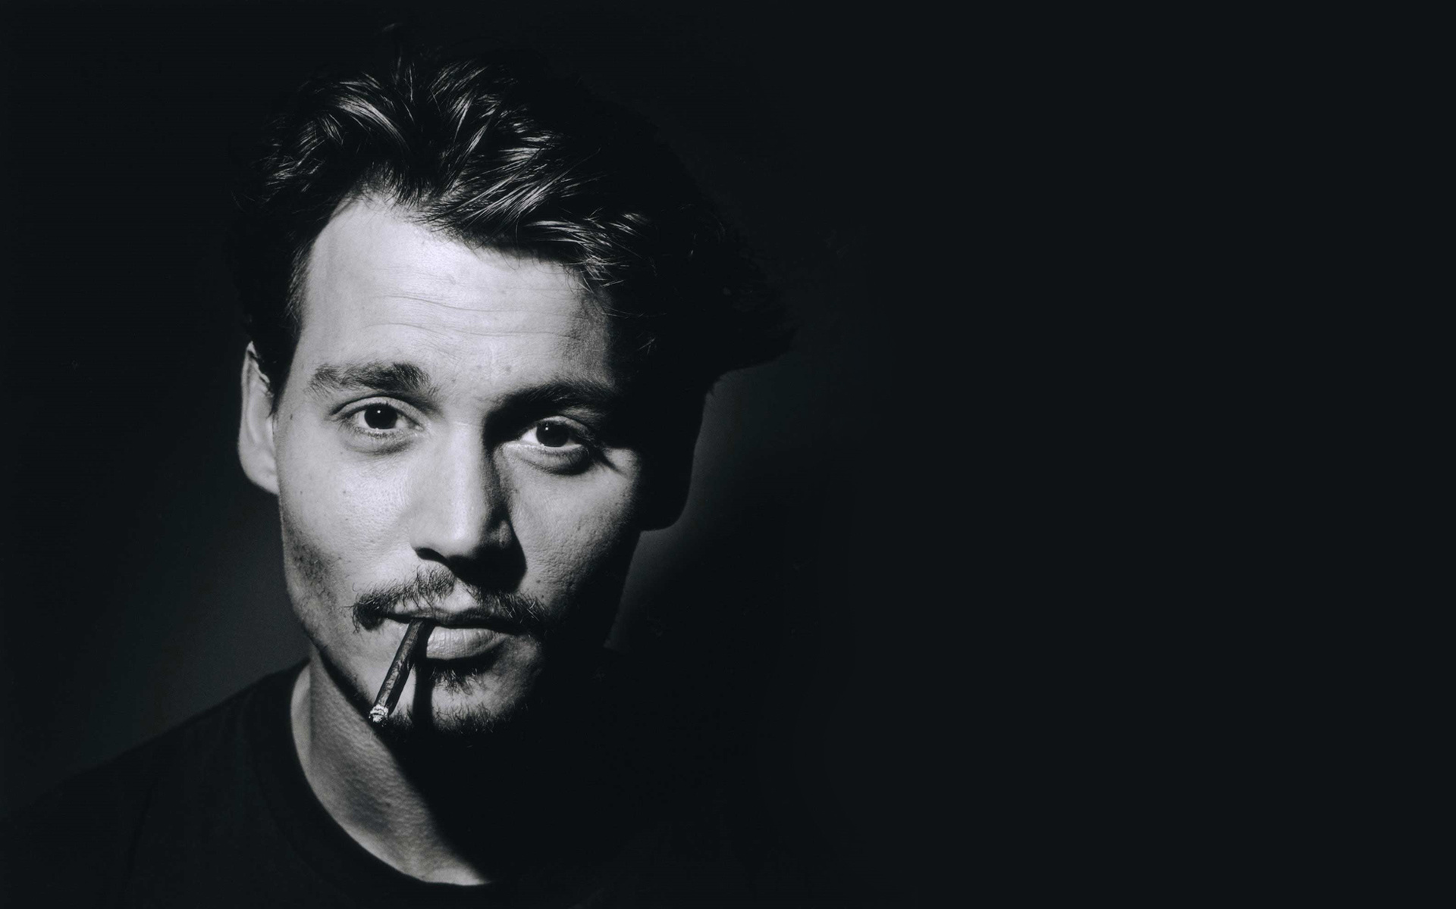
We’re all damaged in our own way. Nobody’s perfect. I think we’re all somewhat screwy. Every single one of us.

Slide 19
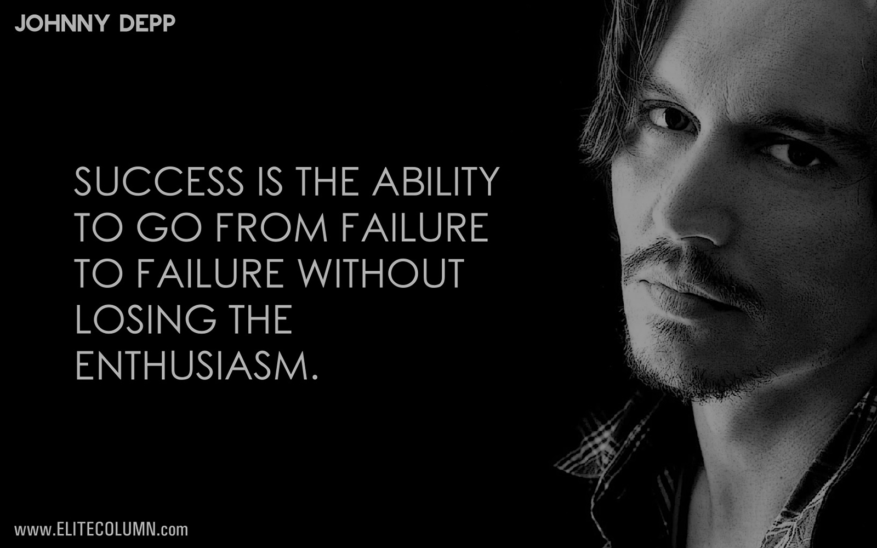

Slide 20
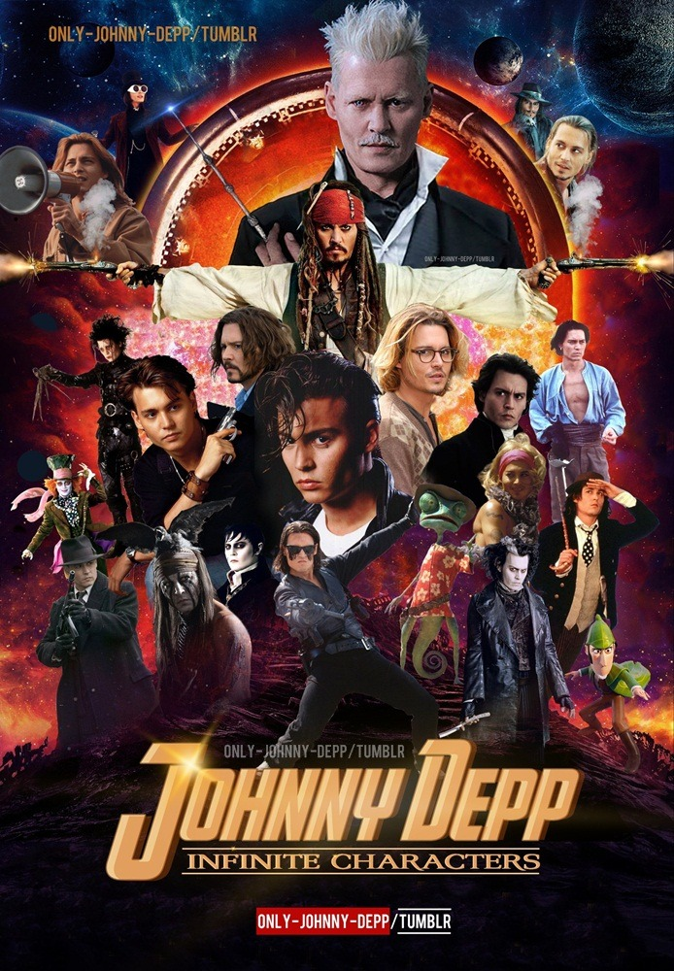
thankyou

